Slide 1

School security system using Finger print sensor
Project guide:
Dr . V. V. Sunil Kumar
Batch Members:
Vaka .Amulya
Pokala.Shasikala
Golla.HemaSwaroopa
Gollapudi.Thirumala

Slide 2
Contents:
Problem statement
Abstract
Existing System
Proposed System
Hardware & Software Requirement
Block Diagram
Working ,Result & Output
Advantages& Applications
Conclusion
Reference

Slide 3
Problem statement
The current methods of managing student attendance are often time-consuming, prone to errors, and lack of real-time monitoring or security measures to prevent unauthorized access.
Requires teachers or staff to manually record and verify attendance.
Traditional attendance tracking in schools in time-consuming

Slide 4
Abstract
The proposed school security system uses finger print sensor integrated with Arduino Uno and NodeMCU to efficiently monitor and record student attendance in real-time.
Each student biometric is taken, which is scanned upon entry or exit, triggering the system to log the data.
An LCD screen displays the student's name and status, while a buzzer alerts staff to any unauthorized or delayed actions.
Additionally, the system sends notifications to administrators and logs all attendance data onto a remote server, accessible through a user-friendly interface.
This centralized system ensures enhanced security, facilitates real-time monitoring, and provides detailed attendance records for school management.

Slide 5
Existing system
Existing school security systems typically rely on manual attendance tracking, CCTV surveillance.
Manual systems, such as roll calls or sign-in sheets, are time-consuming, prone to human error, and lack real-time tracking of student movements.
CCTV cameras monitor areas but do not provide individual student tracking or entry/exit logs.
These existing methods often fail to provide comprehensive security and real-time monitoring, resulting in a need for more advanced, automated systems.

Slide 6
Proposed system
The proposed school security system focuses on efficient entry and exit monitoring using finger print sensor integrated with Arduino Uno and NodeMCU.
Each student finger biometric is taken , which is scanned upon entry or exit, logging the attendance data in real-time.
This system enhances security by ensuring that only authorized individuals enter or leave the premises.

Slide 7
Requirements:
Hardware Components:
Software Components:
Arduino Uno
Node MCU (Wi-Fi Module)
Finger print sensor
LCD Display
Servomotor
Buzzer
Arduino
Blynk software

Slide 8
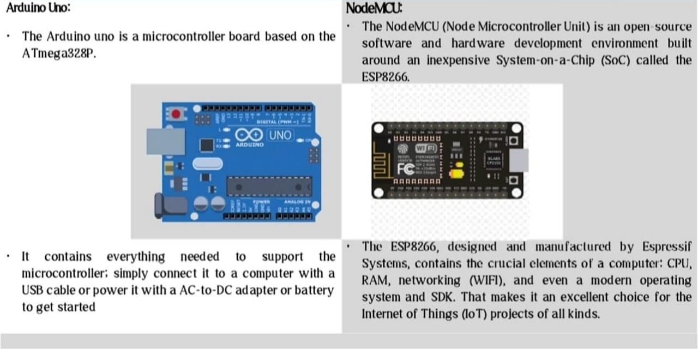
Hardware components of Micro Controller:

Slide 9
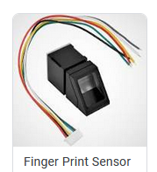
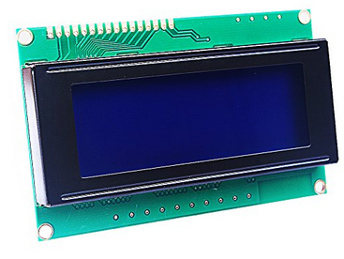
Hardware components: Sensors
A fingerprint sensor in an IoT-based security8. Reports Generation: The system generates attendance reports.9. Stop: The process ends. automation system enables secure access by allowing only authorized users to control appliances through biometric authentication and remote IoT integration. The sensor scans and matches fingerprints, and if verified, the microcontroller (ESP32, ESP8266, or Arduino) activates a relay to switch appliances on or off. This system can be integrated with IoT platforms like Blynk or Firebase for remote monitoring and control.
In IoT-based systems, LCD displays are used to show real-time data, sensor readings, and device statuses, providing a user-friendly interface for monitoring and control. LCD displays in IoT systems enhance user interaction by displaying alerts, connectivity status, and operational feedback, improving real-time monitoring and automation.
LCD Display

Slide 10
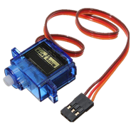
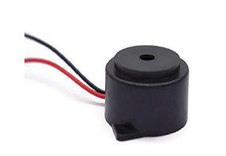
A servo motor is a rotary actuator used for precise control of position, speed, and torque in automation and robotics. In IoT-based systems, it is commonly used for tasks like smart door locks, robotic arms, and automated control mechanisms. It operates using a control signal to adjust its position accurately based on user commands or sensor inputs.
Servo motor
Buzzer
In IoT systems, a buzzer provides audible alerts for events like status changes or errors. It is activated by the microcontroller to deliver real-time notifications, enhancing user responsiveness.

Slide 11
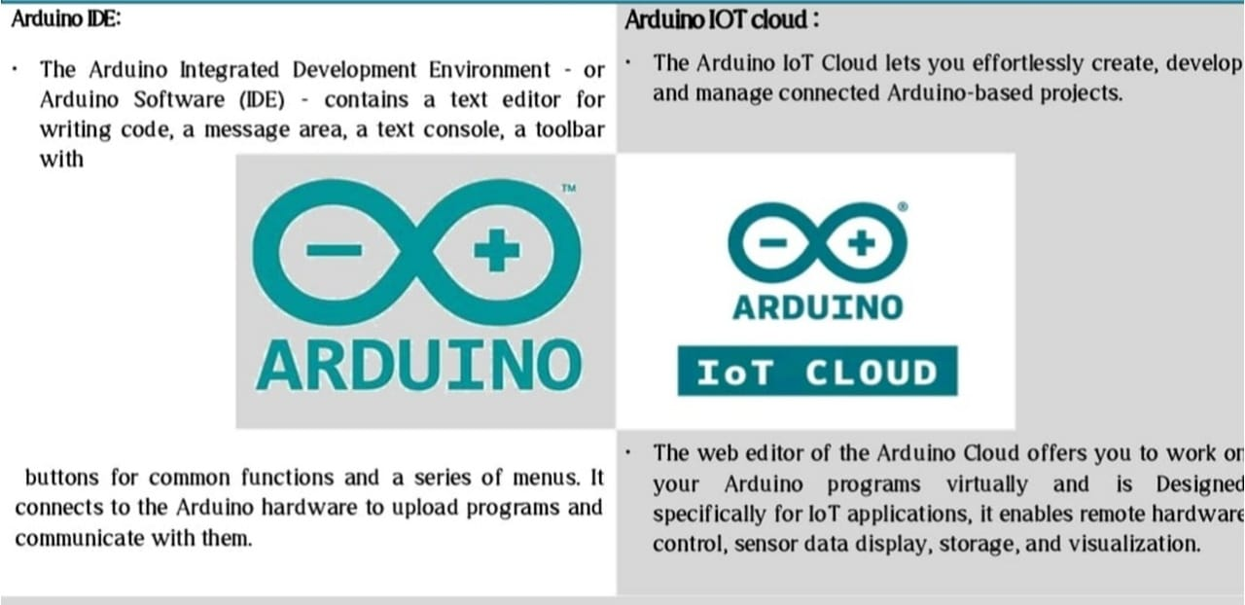
Software Components:

Slide 12
BLOCK DIAGRAM
Arduino Uno
Buzzer
Finger print sensor
Servo motor
LCD
Node MCU
Server
Web user interface

Slide 13
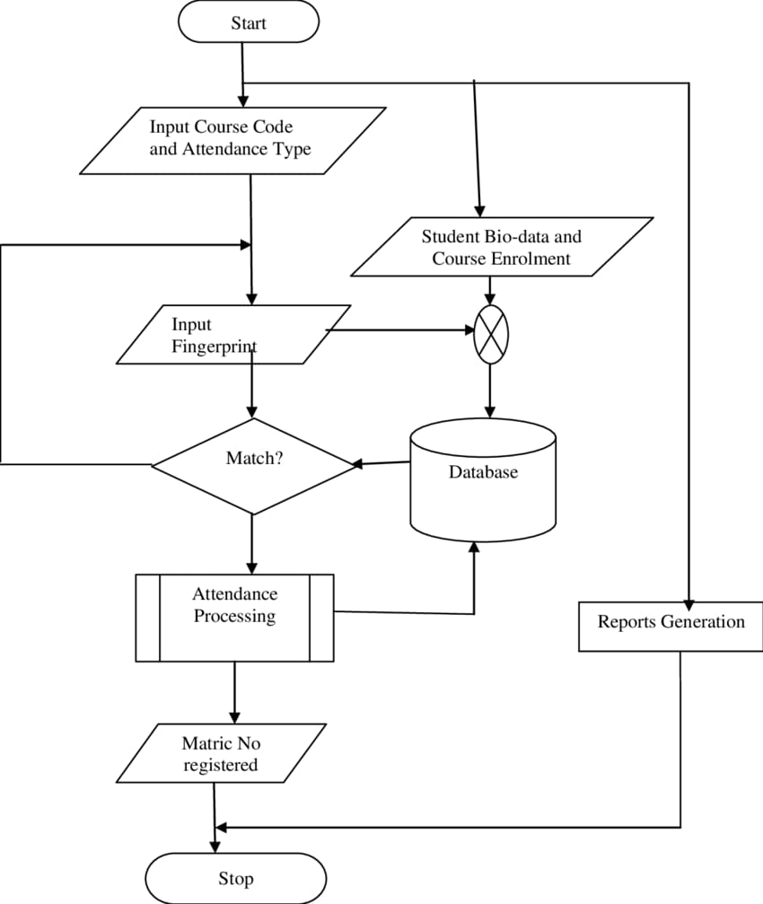
Working:
Start:
The process begins when the system is activated.
Input Course Code and Attendance Type :
Input Course Code and Attendance Type The user (student or administrator) enters the course code to specify which class attendance is being taken.The attendance type (e.g., lecture, practical, or tutorial) is also specified.
Input Fingerprint:
Input Fingerprint The student places their finger on the biometric scanner.The system captures the fingerprint data.

Slide 14
Working:
Match?:
Match? (Fingerprint Verification)The system compares the captured fingerprint against stored records in the database.If the fingerprint does not match, the system prompts the student to retry.If the fingerprint matches, the attendance is processed.
Student Bio-data and Course Enrollment :
The system retrieves the student’s details and enrolled courses from the database.
Attendance Processing:
If the fingerprint is verified, the system records the student’s attendance for the given course and updates the database.
Matric No Registered?:
The system checks if the student’s Matric Number (University Registration Number) is already recorded in the database.If the student is registered, the attendance is confirmed and saved.If the student is not registered, an error message is generated.
Reports Generation: The system generates attendance reports.
Stop: The process ends.

Slide 15
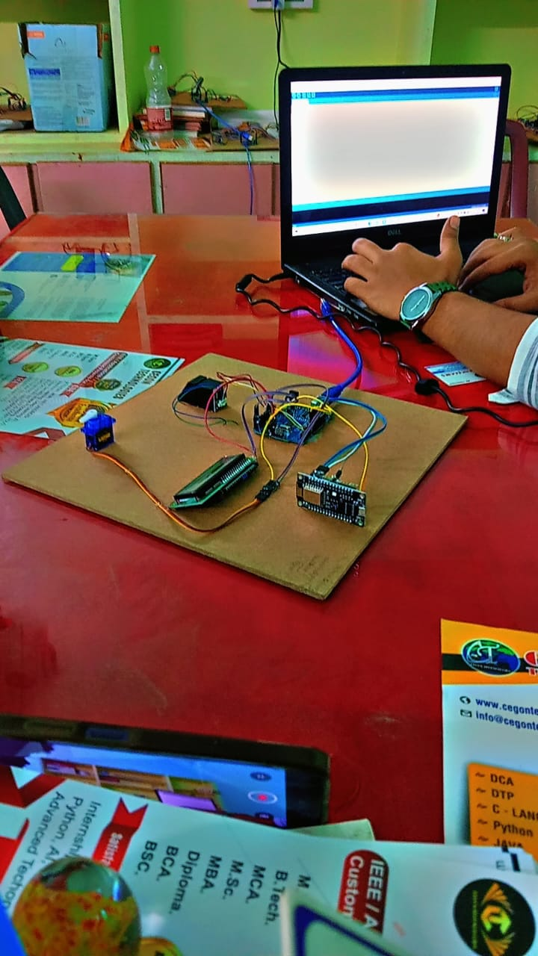
Results&output:

Slide 16
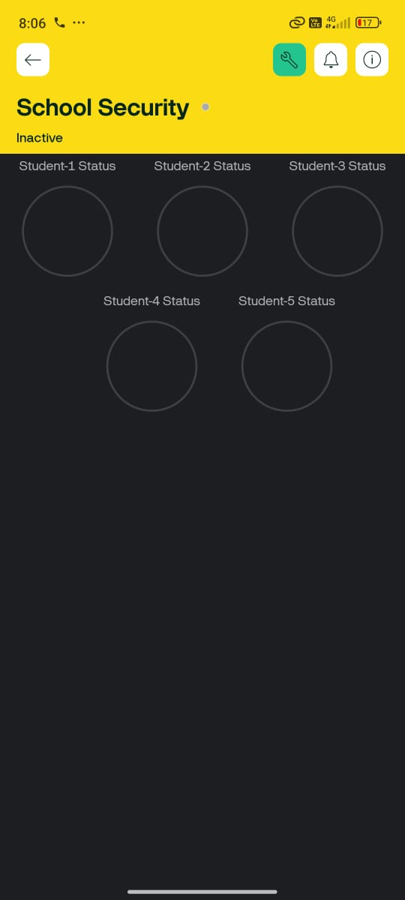

Slide 17
Advantages:
Enhanced Security only authorized students, staff, and personnel can access school premises.
Prevents strangers or unauthorized individuals from entering the school.
Fingerprint scanning is fast ,reducing Overcrowding at entry and exit points.
Fingerprints cannot be lost ,stolen ,or duplicated easily.
If a student is absent automatically notification are sent to their parents phones.
It also prevent ford attendance.
Application:
Student Attendance System
Emergency & Safety Monitoring
Restricated Access to Sensitive Areas

Slide 18
Conclusion:
A fingerprint-based school security system enhances safety by ensuring accurate identification and preventing unauthorized access. It automates attendance, controls entry to restricted areas, secures examinations, and manages visitors efficiently. The system improves school security, reduces manual errors, and enhances transparency with real-time monitoring and parental notifications. By integrating biometric technology, schools can create a safer, smarter, and more organized environment. Implementing this system ensures efficient security management and a secure learning atmosphere for students and staff.

Slide 19
References:
A. Smith, "Security and Monitoring Systems in Schools: A Comprehensive Review," International Journal of Education and Security, vol. 12, no. 3, pp. 45-58, Mar. 2023.
J. Doe and M. Brown, "RFID-Based Attendance System for Schools," IEEE Transactions on Educational Technology, vol. 15, no. 2, pp. 110-118, Apr. 2022.
L. Patel, R. Kumar, and S. Joshi, "Biometric and RFID Systems for School Security," Proceedings of the International Conference on Security Technologies, pp. 22-29, Jan. 2021.
K. T. Nguyen, "The Future of School Security: Integrating IoT and RFID," Journal of School Safety and Security, vol. 8, no. 1, pp. 67-75, Feb. 2020.
M. Singh and P. R. Verma, "A Review of Smart School Systems Using RFID and IoT Technologies," IEEE Access, vol. 11, pp. 5000-5012, May 2023.

Slide 20


